Slide 1
Randomized Clinical Trials with Hybrid Controls - Designs and Considerations
Jiawen Zhu
Principal Statistical Scientist, Genentech
BBSW, Nov. 7-8, 2019

Slide 2
Future trial design options Utilize a hybrid control formed by both external and internal controls
Opportunities
the use of computers, mobile devices, wearables, and other biosensors
huge amounts of health-related data has been rapidly accumulated
development of sophisticated, new analytical capabilities
A way to get there…
Validation on data quality and comparability
Right statistical methods
More challenges in trial operation
Treatment arm 3
R
Interim assessment to allow enrollment of additional patients in control arm
Treatment arm 2
Treatment arm 1
Small control arm
External Control (s): Prior studies, concurrent studies, RWD etc.

Slide 3
What are our choices?
1, Do not use historical/ external control
3, Dynamic borrowing
How much to borrow is updated with current data
2, Pooling
Borrow less
Borrow more

Slide 4
Dynamic borrowing methods (purple, green, blue) achieve similar power gains as full borrowing (red) with much less type I error inflation K. Viele et al 2013
Type I error
Power

Slide 5
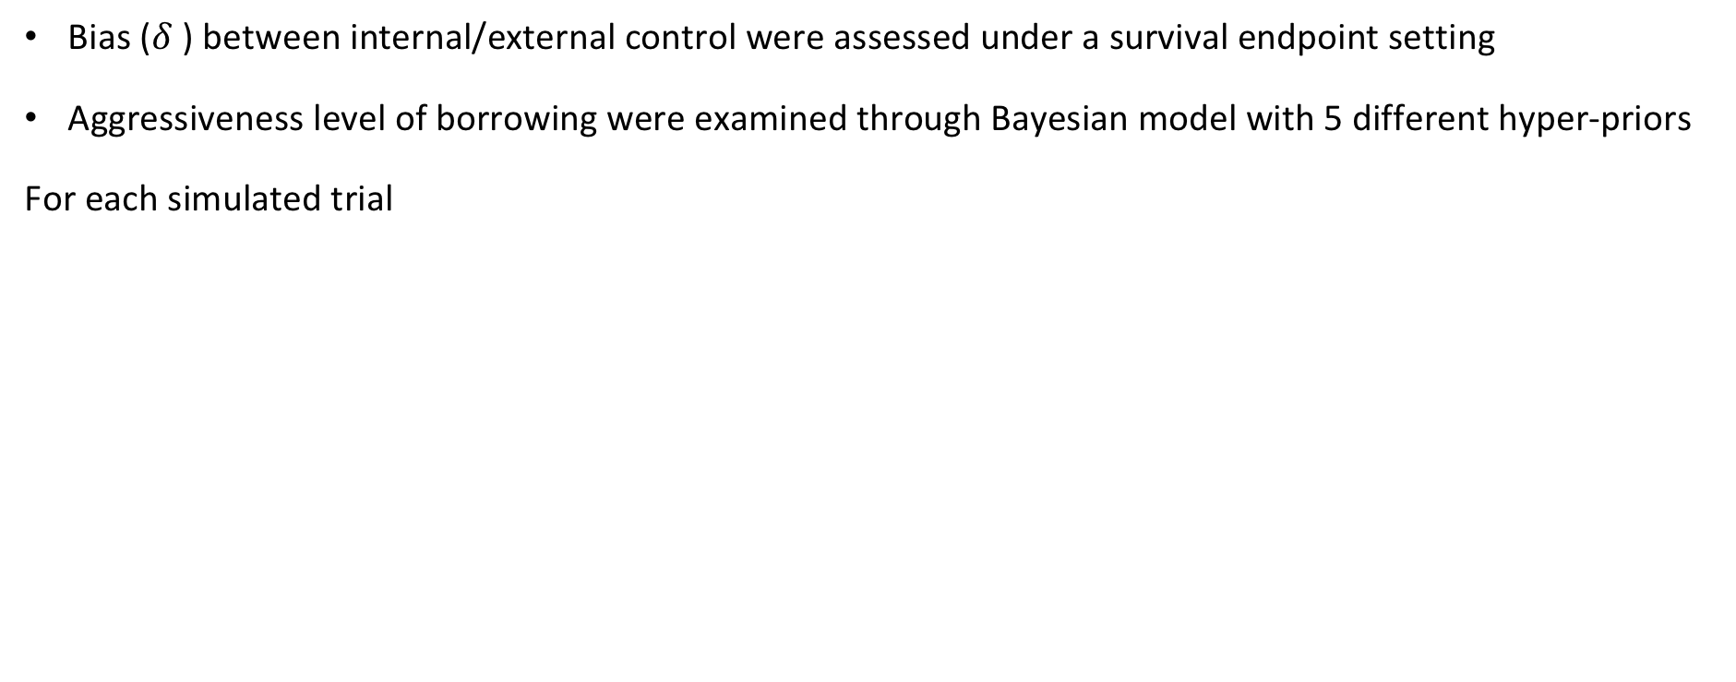
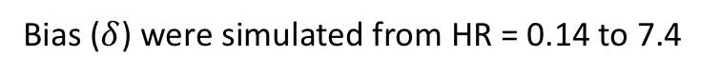
Dive in method operating characteristics Simulation based on commensurate priors approach as an example
Ruilin Li
Bias ($δ$) between internal/external control were assessed under a survival endpoint setting
Aggressiveness level of borrowing were examined through Bayesian model with 5 different hyper-priors
For each simulated trial
Experimental arm (n=100)
Weibull distribution was assumed for time to event endpoint
RCT control median event time is 4 months
RCT treatment arm median event time is set to 4months and 7months
RCT
N=200
R
1:1
Control arm (n=100)
External control (n=200)
Bias ($δ$) were simulated from HR = 0.14 to 7.4
Notes:
delta_vals = c(-2, -1.5, -1, -0.75, -0.5, -0.25,-0.15, -0.05, 0,0.05, 0.15, 0.25, 0.5, 0.75, 1, 1.5, 2)
Treatment effect=0.67
Control mTTE=4months
Alternative treatment mTTE=7months
200 trial data 1:1 randomized (event mature rate =70%) 140 event
200 external 100 event

Slide 6
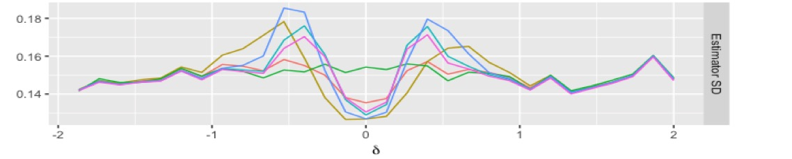
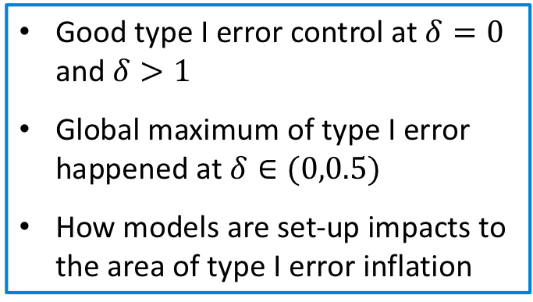
No treatment effect: HR=1
Good type I error control at $δ=0$ and $δ>1$
Global maximum of type I error happened at $δ∈(0,0.5)$
How models are set-up impacts to the area of type I error inflation
0.37
0.6
1
1.65
2.7
HR

Slide 7
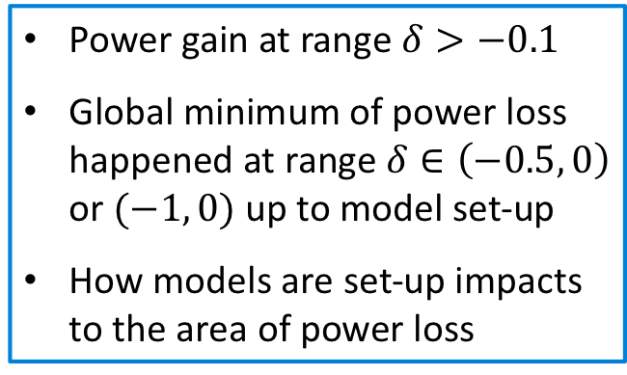
Treatment effect HR=0.67
Power gain at range $δ>−0.1$
Global minimum of power loss happened at range $δ∈\left(−0.5, 0\right)$ or $(−1, 0)$ up to model set-up
How models are set-up impacts to the area of power loss
0.37
0.6
1
1.65
2.7
HR

Slide 8
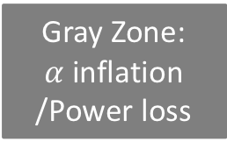
New design variable to consider: Control comparability
External Control
Performs better
Internal/external Control
Very similar
Internal Control
Performs better
Green Zone: Clear benefit
Gray Zone:
$α$ inflation /Power loss
Blue Zone: No borrowing

Slide 9
Post-hoc hybrid control example 1 Borrowing data from an almost identical trial in NSCLC
New treatment
(n=143)
R
Concurrent control (CC)
Docetaxel
(n=143)
Docetaxel
(n=612)
R
New treatment
(n=613)
External control (EC)
Trial B
Ph II
Trial A control
Trial A
Ph III
Trial A new trt
Trial B control
Trial B new trt
Notes:
Use existing trial for POC

Slide 10
Dynamic borrowing objectively accepts external control when controls are comparable
Not borrowing
Full borrowing
Trial A control
Dynamic borrowing
Trial A new trt
Trial B control
Trial B new trt
resample 50 pt/arm from trial A and borrow control from trial B (n=143)
Notations: CC: concurrent control from trial A
EC: external control from trial B

Slide 11
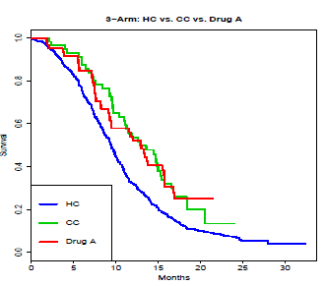
Post-hoc hybrid control example 2 Borrowing data from historical studies in mCRC
Study | EC1 (2008) | EC2 (2012) | More Recent: Trial C
Treatment | Folfox+Bev (n=349) | Folfox+Bev (n=64) | Folfox+Bev (n=62) | New treatment (n=63)
ORR(%) | 47 | 47 | 64 | 58.7
Median DoR(mo) | 8.3 | 9.9 | 11.1 | 10.8
Median PFS (mo) | 9.5 | 9.9 | 12.8 | 13.1
PFS
Green: control data from trial C (n=62)
Red: New treatment from trial C (n=63)
Blue: control data from pooled historical/external trial D and E (n=413)

Slide 12
Dynamic borrowing objectively downweighs external control when controls are not comparable
Not borrowing
PFS
Full borrowing
Dynamic borrowing
Green: control data from trial C (n=62)
Red: New treatment from trial C (n=63)
Blue: control data from pooled EC1 and EC2 (n=413)
Trial C borrow control from trial EC1 and EC2
Notations:
CC: concurrent control, EC: external control

Slide 13
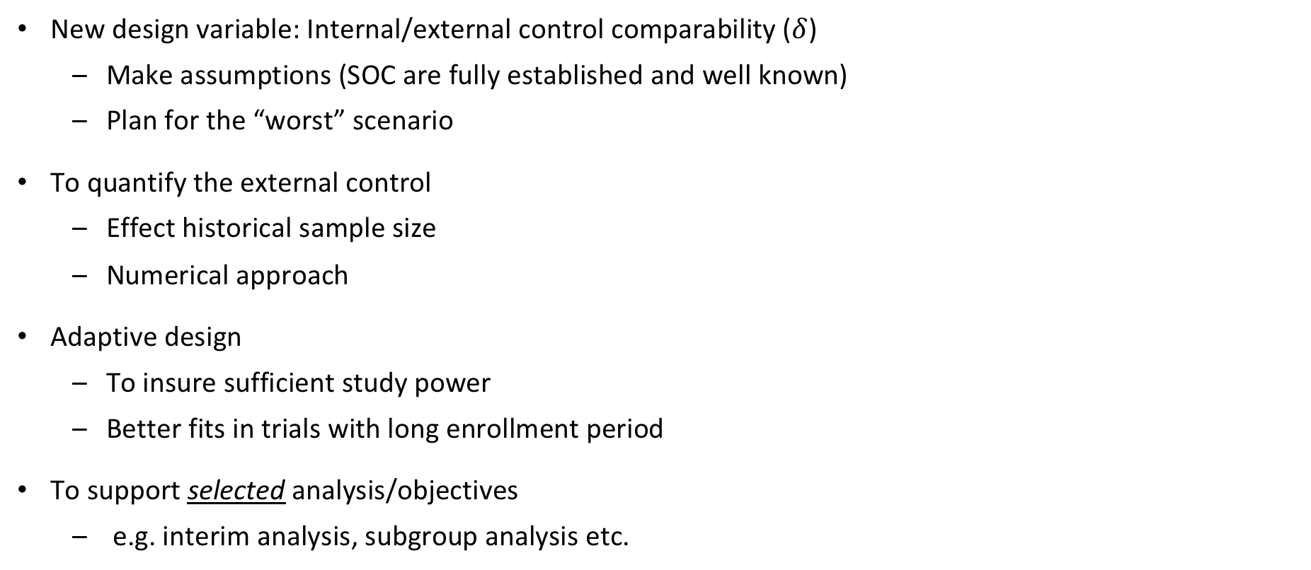
When design a hybrid control trial
New design variable: Internal/external control comparability ($δ$)
Make assumptions (SOC are fully established and well known)
Plan for the “worst” scenario
To quantify the external control
Effect historical sample size
Numerical approach
Adaptive design
To insure sufficient study power
Better fits in trials with long enrollment period
To support selected analysis/objectives
e.g. interim analysis, subgroup analysis etc.
$$EHSS≈n_{hist}\{(\text{Prec}\text{(}θ|D,D_{0}\text{))}/\text{(}\text{Prec}\text{(}θ|D\text{)}) −1\}$$

Slide 14
Design example 1: a “Minimally invasive” hybrid control trial
New Treatment
Design study with planed power at final analysis
Enables more informative decision making at interim analysis
Possibility to bring in decision timeline
Minimal modification
No sample size saving
Potential place to employ:
POC trials, confirmatory trial with HA buy-in
R
Control
X:1
IA
FA
External Control (s): Recent in house studies, RWD etc.

Slide 15
Design example 2: an adaptive hybrid control trial
Design study with X:1 randomization ratio
Design interim look(s) for control comparability assessment
Adjust the randomization ratio when the interim indicates commensurable sets of controls
Operational-wise is more challenging
Potential place to employ:
confirmatory trials in rare disease
Ongoing trial
1:1
New Treatment 1
R
Control
control
R
New treatment 2
X:1
Hybrid control trial

Slide 16
Hybrid control trial design decision flow: 7 steps
Trial objective:
POC vs. confirmatory
External data availability and quality
Evaluate potential level of bias between internal and external controls
Trial operation considerations, e.g. enrollment speed
Pre-specify study design and trial success criteria
Use simulation to evaluate and support final design decision
Determine analyses, select analysis method and model hyper-prior (Bayesian approach)

Slide 17
Summary
It is an emerging field, a lot of opportunities for industry- industry, industry-academia collaborations
It’s critical to assess control data quality and potential bias before designing a study
More fine tunings and planning are required than standard trial
Trial OC simulation will be needed for each trial design
Pre-specify method and analysis plan in SAP and be transparent!

Slide 18
Acknowledgement
External collaborators:
Somnath Sarkar, Brad Carlin, Ruilin Li, James Normington, Connor Jo Lewis
Roche/Genentech Biostatistics colleagues:
Cornelia Irl, Qi Xia, Jane Fridlyand, Imola Fodor, Federico Mattiello, Ray Lin, Joseph N. Paulson
Roche/Genentech real world data scientist colleagues:
Natalia Sadetsky, Angela Hsieh

Slide 19
Reference
TransCelerate PSoC Workshop outline, 11-12 Oct 2016, Jersey City
Pocock SJ. The combination of randomized and historical controls in clinical trials. J Chron Dis 1976;29:175–88.
Viele K, Berry S, Neuenschwander B, Amzal B, Chen F, Enas N, et al. Use of historical control data for assessing treatment effects in clinical trials. Pharmaceut Statist 2014;13:41–54.
Lim, J., R. Walley, J. Yuan, J. Liu, A. Dabral, N. Best, A. Grieve, L. Hampson, J. Wolfram, P. Woodward, et al. 2018. Minimizing patient burden through the use of historical subject-level data in innovative confirmatory clinical trials: Review of methods and opportunities. Therapeutic Innovation & Regulatory Science 52:546–559
Lewis, C.J., Sarkar, S., Zhu, J., and Carlin, B.P. (2018) Borrowing from Historical Control Data in Cancer Drug Development: A Cautionary Tale and Practical Guidelines, accepted by Statistics in Biopharmaceutical Research
Normington, J., Zhu, J., Mattiello, F. Sarkar, S., and Carlin, B.P. An effective Bayesian platform trial design for borrowing adaptively from historical control data in lymphoma, submitted to CCT
Pennello, G. and Thompson, L. (2008). Experience with reviewing Bayesian medical device trials. J. Biopharmaceutical Statistics, 18, 81(115).
Hobbs, B.P., Carlin, B.P., and Sargent, D.J. (2013). Adaptive adjustment of the randomization ratio using historical control data. Clinical Trials, 10, 430 440.
Chen, N., Carlin, B.P., and Hobbs, B.P. (2017). Web-based statistical tools for the analysis and design of clinical trials that incorporate historical controls. Research report, Division of Biostatistics, University of Minnesota. Submitted to J. Statistical Software.
Irony, T. (2019) Regulatory Perspectives when Leveraging Complex Innovative Trial Designs. DIA/FDA Biostatistics Industry and Regulator Forum, Bethesda, April 8-10, 2019

Slide 20
Doing now what patients need next

